Slide 1
DATABASE MANAGEMENT SYSTEM
B. Tech. II CO (Sem-4th)
Credits: 5 (L:3 T:1 P:2)

Slide 2
Covering
Data
Need of Database
Database
  Collection of related data (recorded facts)
DBMS
  Generalized software package for implementing and maintaining a computerized database
  Provides many services to manage data resources
Categories of database users
When Not to Use a DBMS

Slide 3
Data
A raw fact or unorganized form (such as alphabets, numbers, or symbols) that refers to or represent, condition, ideas or objects
Limitless and present everywhere in the universe

Slide 4
Information
Data which
Verified to be accurate and timely
Specific and organized for a purpose
Represented within a context that gives it meaning and relevance
Lead to an increase in understanding and decrease in uncertainty is called information

Slide 5
Applications
Traditional database applications
  Store numeric short textual information
  Typically for managing enterprises
Text and multimedia databases
  Store documents, digital images, audio, and video streams
Geographic information systems (GIS)
  Store maps, weather data, and satellite images
  For route-finding, agriculture, and natural resource management
Data warehouses and online analytical processing (OLAP) systems
  Store historical business information
  For business analytics and decision support
Real-time and active database technology
  Store process models, constraints, and key performance indicators
  Control industrial and manufacturing processes

Slide 6
Need of DBMS
Earlier existing traditional file processing
  For a given problem, each user defines and implements the files needed for a specific software application
  As the application base grows
    Many shared files
    Multitude of file structures
    Need to exchange data among applications
Issues
  Redundancy: multiple copies
  Inconsistency: independent updates
  Inaccuracy: concurrent updates
  Incompatibility: multiple formats
  Insecurity
  In-auditability: poor chain of responsibility
  Inflexibility: changes are difficult to apply

Slide 7
Drawbacks of Traditional File Processing
  Atomicity of updates
    Failures may leave database in an inconsistent state with partial updates carried out
    Example: Transfer of funds from one account to another should either complete or not happen at all
  Concurrent access by multiple users
    Concurrent access needed for performance
    Uncontrolled concurrent accesses can lead to inconsistencies
      Example: Two people reading a balance (say 100) and updating it by withdrawing money (say 50 each) at the same time
  Security problems
    Hard to provide user access to some, but not all, data

Slide 8
Database Approach
Single repository maintains data that is defined once and then accessed by various users
Offer solutions to problems by Abstraction, Schema, Data Models
Addresses a variety of problems
  No Redundancy: no multiple copies
  Consistency
  Accuracy: concurrent updates
  Compatibility: multiple formats
  Security: proliferation
  Auditability: chain of responsibility
  Flexibility: changes are easy to apply

Slide 9
Characteristics of the Database Approach
Programs isolated from data through abstraction
  Does not expose details of how (or where) data is stored or how operations are implemented
  Data sharing through multiple views
Multiuser transaction processing
  Encapsulates sequence of operations to behave atomically
Data is self-defining
  Database system contains complete definition of structure and constraints as meta-data
  Database catalog used by
    DBMS software
    Database users who need information about database structure

Slide 10
Course Content
Introduction to database systems
Relational data model
SQL
Relational algebra
Entity-Relationship (ER) model
Extended ER model
Mapping ER models to relational
DBMS architecture
Views and view management
PL-SQL
Transactions, Concurrency, Recovery
Query Processing, Query Optimization
Data Mining and Data warehouses

Slide 11
Goal
  Implement a database in DBMS software, define schemas, develop queries and perform manipulations in SQL
  Transform a business description into Entity-Relationship diagrams, which were then used to specify a SQL Schema
  Apply knowledge of data redundancy, security, backups and recovery, data dependencies and other constraints in database design

Slide 12
Subject Assessment Plan
Theory and Practicals
  Laboratory assignments for different topics
  A project
    The project is an end-to-end design and implementation project to model part of an enterprises database (e.g. product and sales data for a retailer), create the database using SQL (on Oracle or PostgreSQL), populate it with data, and use JDBC to implement several simple user interfaces to the database (As done software tools – I, web based interface for the project is needed).
Quizzes

Slide 13
Books
1). A Silberschatz, H. F. Korth, and S Sudarshan, "Database System Concepts", 6/E,TMH, 2006
2). McFadden, F. Hoffer, Prescott : M. B “Modern Database Management”, 8/E, Benjamin/Cummings Inc,2006
3). C. J Date, “An Introduction to Database Systems”, Publisher: Addison, Wesley, 8/E, 2003
4). Raghu Ramakrishnan and Gehrke: “Database Management System”, 3/E, WCB/McGraw-Hill,2003
5). Margaret H Dunham , “Data Mining. Introductory and advanced topics”, Pub: Pearson Education, 2003
Ivan Bayross, SQl, PL/SQL The Programming Language of Oracle, BPB Publications

Slide 14
Terminology
Database
  Collection of related data (logically coherent)
  Known facts that can be recorded and that have implicit meaning
  Represents some aspect(s) of the real world
  Built for a specific purpose
Examples of large databases
  Amazon, Organization

Slide 15
Terminology (cont'd.)
Database Management System (DBMS)
  Collection of programs
  Enables users to create and maintain a database
  Allows multiple users and programs to access and manipulate the database concurrently
  Provides protection against unauthorized access and manipulation
  Provides means to evolve database and program behaviour as requirements change over time
Examples of database management systems
  IBM’s DB2
  Microsoft’s Access
  Microsoft’s SQL Server
  MySQL
  Oracle

Slide 16
Utilization of DBMS
Define a database
  Specify the data types, structures, and constraints of the data to be stored
  Uses a Data Definition Language
Meta-data
  Database definition or descriptive information
  Stored by the DBMS in the form of a database catalog or data dictionary
Phases for designing a database:
  Requirements specification and analysis
  Conceptual design
    e.g., using the Entity-Relationship model
  Logical design
    e.g., using the relational model
  Physical design

Slide 17
Utilization of DBMS (cont'd.)
Populate a database
  Insert data
Query
  Interaction causing some data to be retrieved
  Uses a Query Language
Manipulate a database
  Query and update the database to understand
  Generate reports
  Uses a Data Manipulation Language
Application program
  Accesses database by sending queries and updates to DBMS
Transaction
  An atomic unit of queries and updates that must be executed as a whole
    e.g., buying a product, transferring funds

Slide 18
Utilization of DBMS (cont'd.)
Reorganize a database
  Changes the metadata rather than the data
  More drastic than data updates
    May require massive changes to the data
    May require changes to some application programs
  Uses the Data Definition Language again

Slide 19
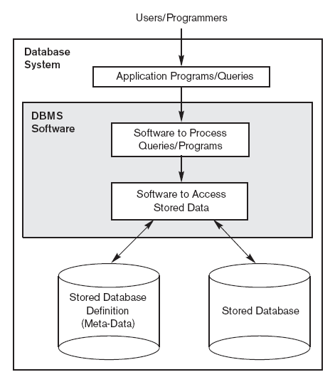
Database System Overview

Slide 20
An Example
University database
  Information concerning Students, Instructors, Departments, Sections
Data records
  Student
  Instructor
  Subject Coordinator
  Student Class
Define structure of each type of record by specifying data elements to include and data type for each element
  String (sequence of alphabetic characters)
  Numeric (integer or real)
  Date (year or year-month-day)
  Monetary amount
  etc.

Slide 21
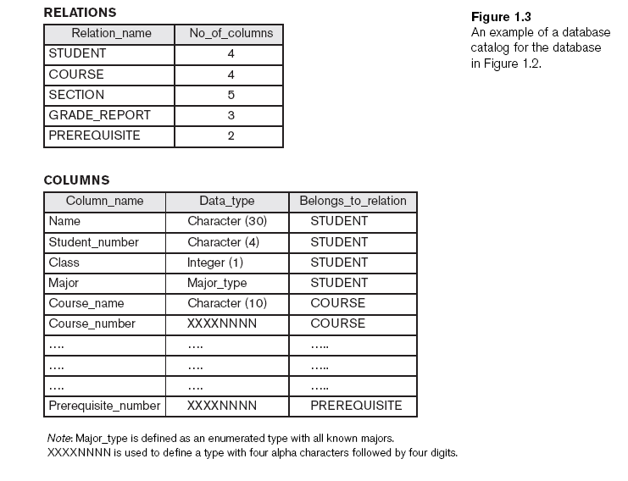
An Example

Slide 22
An Example (cont'd.)
Populate University database
  Store data to represent each Student, Instructor, Subject taking faculty, Student studying in Section, etc.
Manipulation involves querying and updating
  Examples of queries:
    Who enrolled a Computer Engineering Department in 2012?
    List the students for Computer Engineering Department according to region.
    Who taught subjects to students of Computer Engineering Departments?
    List students having highest CGPA from all departments.
  Examples of updates:
    Add another 10,000 to the gross earnings for instructor 12210.
    Change the address of instructor 10000.
    Update the student semester information on passing with grades other than FF.

Slide 23
Terminology (cont'd.)
Reorganizing a database
  Changes the metadata rather than the data
  More drastic than data updates
    May require massive changes to the data
    May require changes to some application programs
  Uses the Data Definition Language again
Examples:
  Copy pass out students in new “alumni” relation.
  Change date of birth to yyyy/mm/dd format.
  Split name in instructor to separate surname from given names.

Slide 24
When Not to Use a DBMS
More desirable to use regular files for:
  Simple, well-defined applications with no expected changes at all
  Small variety of data and/or small amount of data
  Stringent, real-time requirements that cannot afford DBMS overhead
  Only single (personal) access to data
Unlikely that any of these apply to corporate data management.
  In fact, corporations often maintain many databases across many database systems.

Slide 25

End of the presentation

Slide 26
References
A Silberschatz, H. F. Korth, and S Sudarshan, "Database System Concepts", 6/E,TMH, 2006
https://www.postgresql.org/docs/8.0/connect-estab.html

